Slide 1
Learning Quest

Slide 2
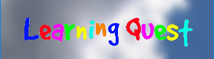
Tag Line
Learning Quest is a colourful playground adventure where even the sky isn’t the limit. Run and jump from swings to clouds picking up letters to spell words and progress through levels.

Slide 3
Changes from last time
Changes that we have made include:
A coin system so that players can buy hints to help with the level.
Random letter generation that spaces out the letters and makes sure that none of them overlap.
We have added physics to a few of the letters so that they fly onto the screen.

Slide 4
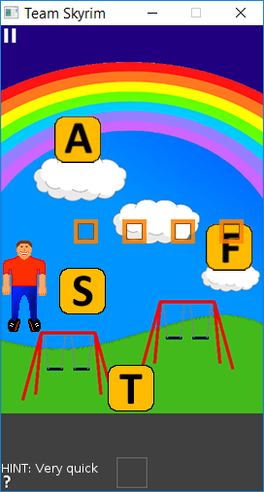
Gameplay
The aim of the game is to collect all of the letters on the screen in the correct order to make the word.
Collected incorrect letters can be tapped to put them back into the world.
A level is complete when the word is correctly spelled.

Slide 5

Target Audience
Children aged 5-8
Bright, colourful backgrounds
Age appropriate words to find
Appropriately worded hints

Slide 6
Player Retention
Daily rewards that will go up in value everyday. This will reset every 5 days unless the player doesn’t log in everyday.
These rewards will be our in-game currency starting with 10 coins on day 1 to 50 on day 5.

Slide 7
Play sessions
The average play session of Learning Quest is likely to be 5-10 minutes as players will want to sign in daily to collect their daily rewards, and then they will hopefully stick around to play a few levels.
Players will also be attracted to the mentally challenging aspect of the game.

Slide 8
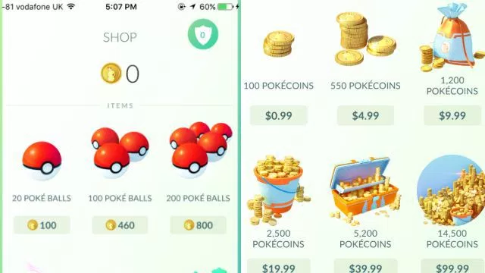
Micro transactions
Able to buy the in-game currency.
For more money, players can get better deals on the in-game currency.
At the start of the game, players will be given a small amount of in-game currency to play with which will hopefully entice them into buying more.

Slide 9

Adverts
After a couple of levels has been completed, an advert will pop up.
These can be removed with a one time purchase or if the player buys enough of the micro transactions.

Slide 10
Future
In the future we plan to ship the following updates to Learning Quest:
Extra character skins, some of which can be micro transactions
More levels with different challenges and environments
Seasonal events with limited skins and environments
Graphical Improvements
Better support for tablet devices
Different subjects to add more variance, e.g. a maths set of levels to add more learning capabilities.

